Slide 1
Cyclist Bike – Share Analysis
Analysed by Balachander.S

Slide 2
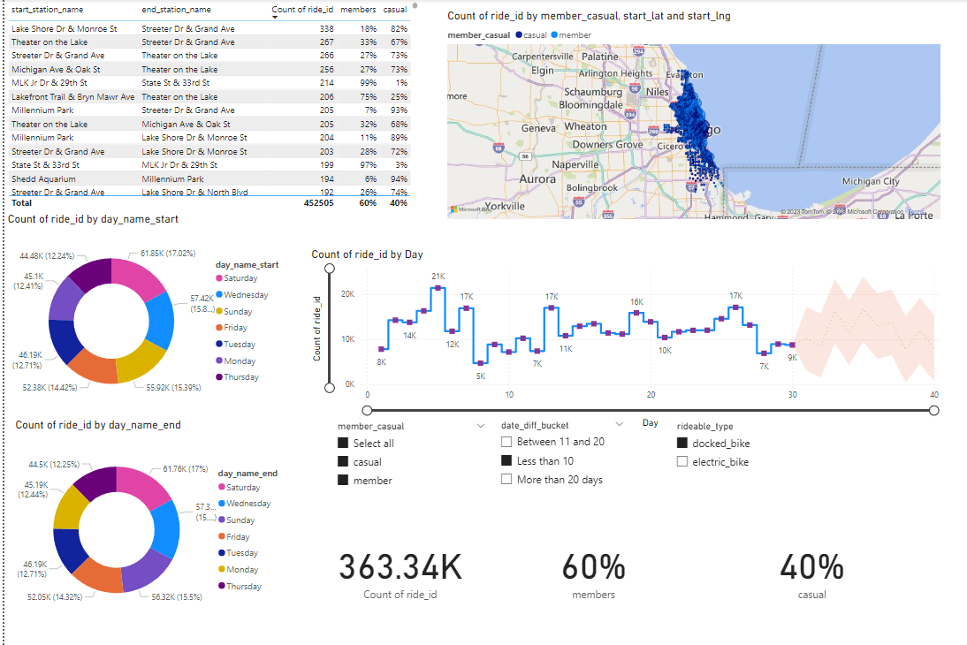

Slide 3
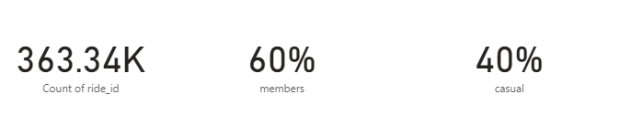
Cards shows id, casual, members

Slide 4

Slicer:
Slicer is used to for docked_bike and electric_bike.
Tile is selected for the view.

Slide 5

Slicer:
Slicer is used for category of casual and member

Slide 6
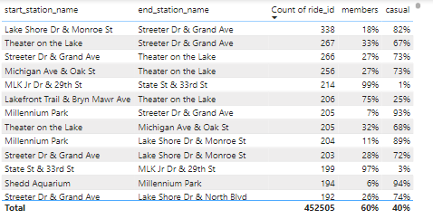
Table contains start and end station name

Slide 7
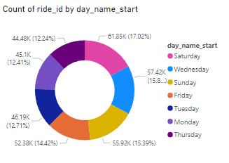
Count of day name start

Slide 8
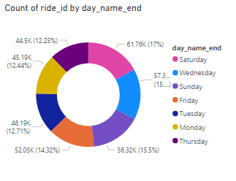
Donut chart shows day name end

Slide 9
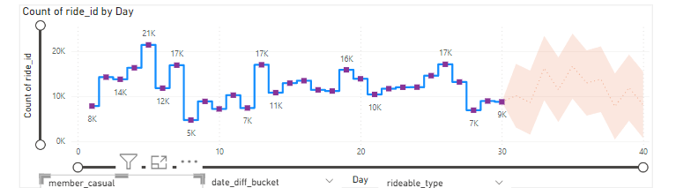
Bar chart:
Bar chart shows the count of start_station_name and end_station_time.
The chart shows the forecast of member.

Slide 10
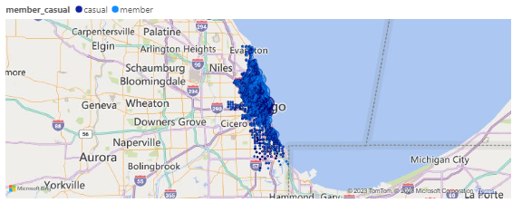
Map shows start lat and long.

